Slide 1
CISL's Data Assimilation Research Section: Accelerating NCAR Science with Ensemble Data Assimilation

Slide 2
Outline
Intro to Ensemble Data Assimilation
Intro to DART
Example Collaborative Projects (with team introductions)
Data Assimilation Science in DAReS
Exciting new projects

Slide 3


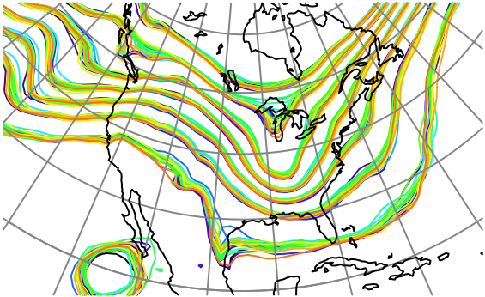
What is Data Assimilation?
Observations combined with a Model forecast …
+
…to produce an analysis (best possible estimate).

Slide 4
Uncertainty and Ensemble Data Assimilation
Uncertainty is a key aspect of Earth System Data Assimilation (DA).
All observations have random errors (my thermometer is not exact).
Usually not as many observations as one would like (it’s a big world).
Errors grow as forecasts get longer (models are ‘chaotic’).
Use an ensemble (a set) of forecasts.
These can give an idea of the uncertainty.

Slide 5
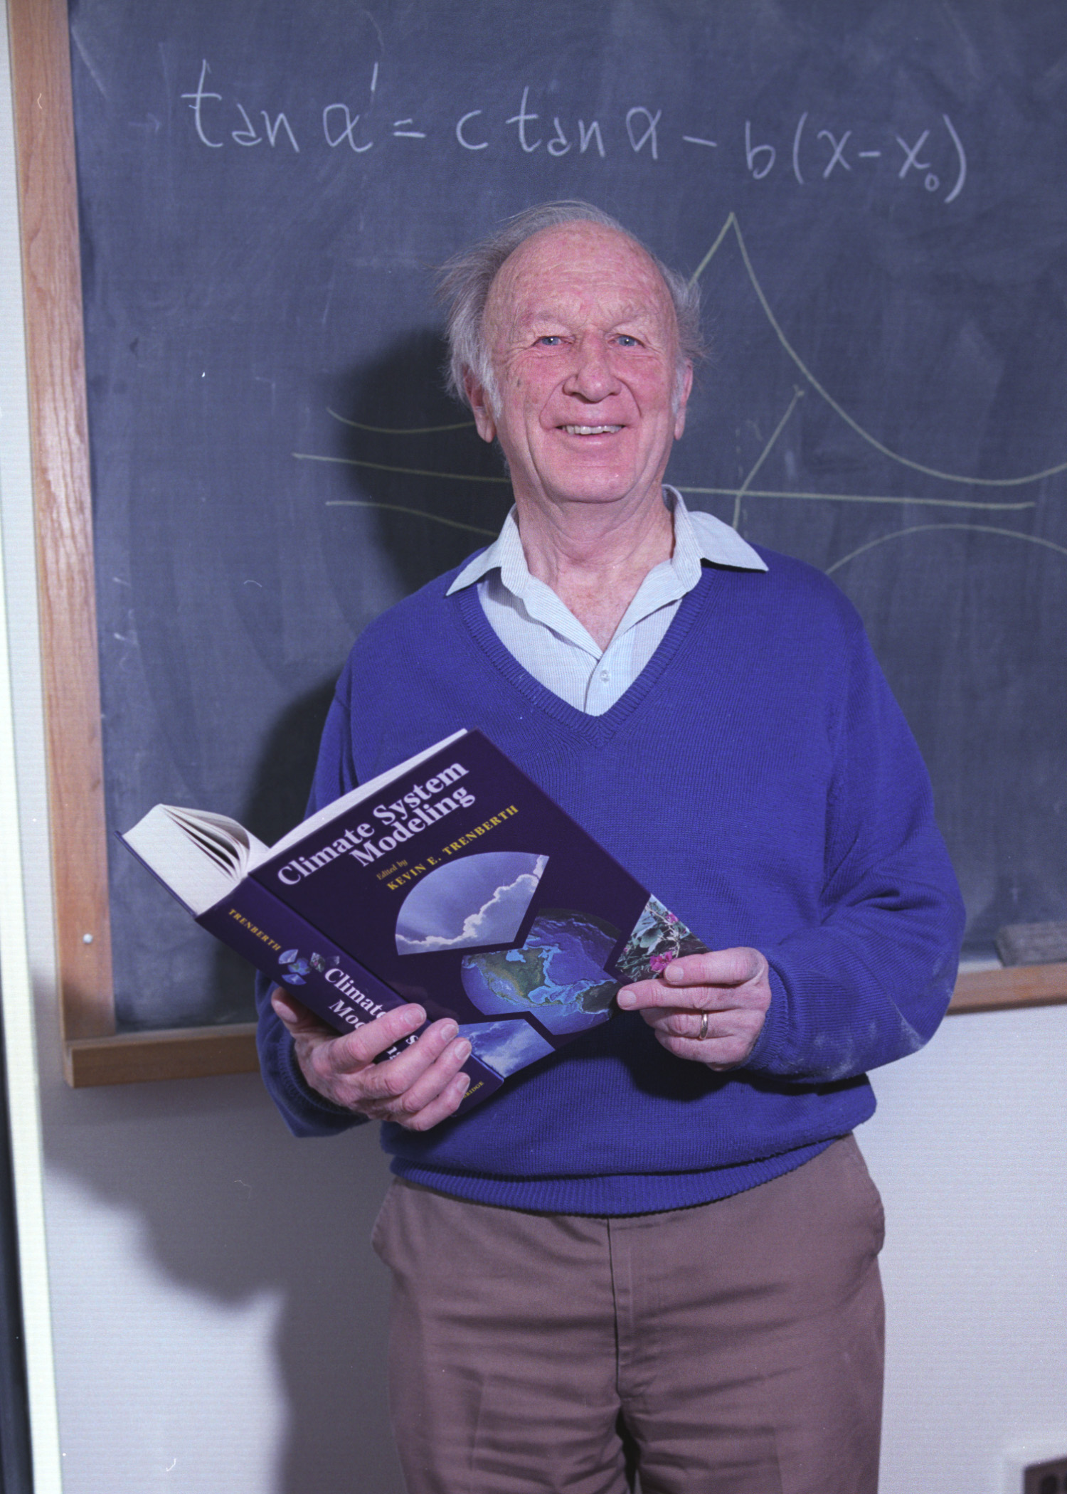
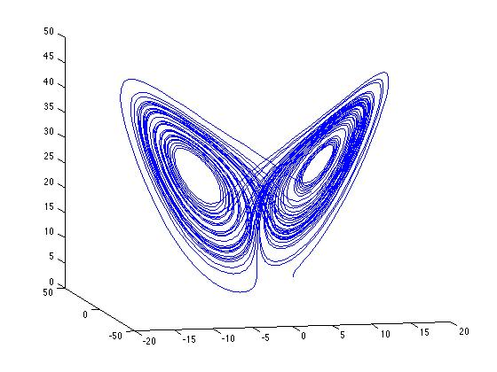
Ensemble DA in the Lorenz Model
In 1963, Ed Lorenz made a very simple model of convection.
It only has 3 variables.
Surprise! Very small differences at the start become HUGE for long forecasts.
Model also describes how a ball moves in space.

Slide 6
Ensemble DA in the Lorenz Model
We’ll show an example with 20 ensemble members.
One solution of model is defined to be the ‘truth’.
‘Observations’ are created by adding random error to truth.
Observations only every 6 hours.

Slide 7
Simple Example: Lorenz 63 3-variable chaotic model
Observation in red.
Prior ensemble in green.
Observing all three state variables.
Obs. Error variance = 4.0.
Four 20-member ensembles.
Notes:
Image is s17f02.eps

Slide 8
Simple Example: Lorenz 63 3-variable chaotic model
Observation in red.
Prior ensemble in green.
Notes:
Image is s17f03.eps

Slide 9
Simple Example: Lorenz 63 3-variable chaotic model
Observation in red.
Prior ensemble in green.
Notes:
Image is s17f04.eps

Slide 10
Simple Example: Lorenz 63 3-variable chaotic model
Observation in red.
Prior ensemble in green.
Notes:
Image is s17f05.eps

Slide 11
Simple Example: Lorenz 63 3-variable chaotic model
Observation in red.
Prior ensemble in green.
Ensemble is passing through an
unpredictable region.
Notes:
Image is s17f06.eps

Slide 12
Simple Example: Lorenz 63 3-variable chaotic model
Observation in red.
Prior ensemble in green.
Part of the ensemble heads for one
lobe, the rest for the other..
Notes:
Image is s17f07.eps

Slide 13
Simple Example: Lorenz 63 3-variable model
Observation in red.
Prior ensemble in green.
Notes:
Image is s17f08.eps

Slide 14
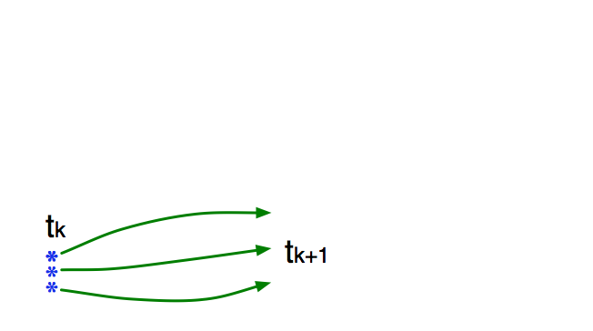
Ensemble Kalman Filter: The Details
Use model to advance ensemble (3 members here) to time at which next observation becomes available.
Ensemble state estimate after using previous observation (analysis)
Ensemble state at time of next observation (prior)

Slide 15
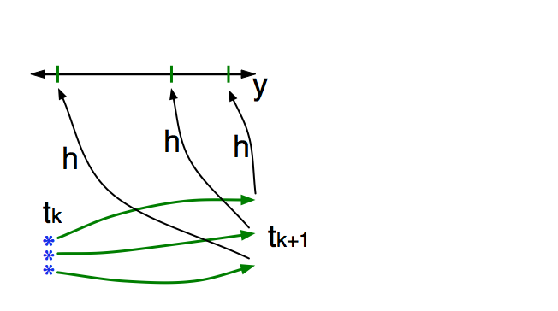
Ensemble Kalman Filter: The Details
Get prior ensemble sample of observation, y = h(x), by applying forward operator h to each ensemble member.
Theory: observations from instruments with uncorrelated errors can be done sequentially.
Notes:
Houtekamer and Mitchell 2001 MWR

Slide 16
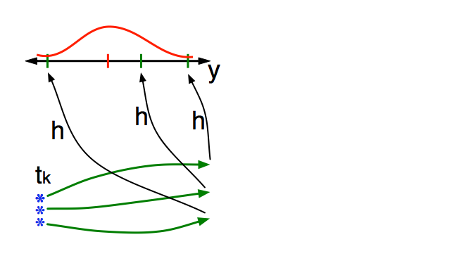
Ensemble Kalman Filter: The Details
Get observed value and observational error distribution from observing system.

Slide 17
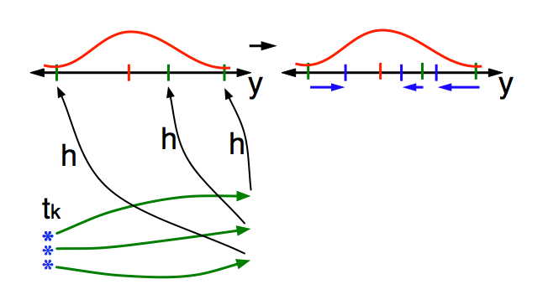
Ensemble Kalman Filter: The Details
Find the increments for the prior observation ensemble (this is a scalar problem for uncorrelated observation errors).

Slide 18
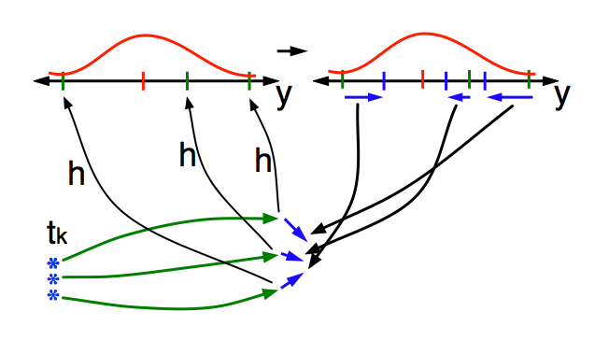
Ensemble Kalman Filter: The Details
Use ensemble samples of y and each state variable to linearly regress observation increments onto state variable increments.
Theory: impact of observation increments on each state variable can be handled independently!
Notes:
Anderson, J.L., 2003: A local least squares framework for ensemble filtering. Mon. Wea. Rev., 131, 634-642

Slide 19
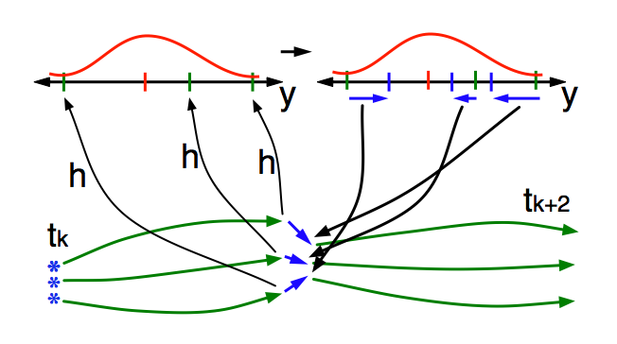
Ensemble Kalman Filter: The Details
When all ensemble members for each state variable are updated, there is a new analysis. Integrate to time of next observation …

Slide 20
The Data Assimilation Research Section (DAReS)
Mission: To accelerate progress in Earth System Science at NCAR, UCAR Universities, and in the broader science community by providing state-of-the-art ensemble DA capabilities.
Method: DAReS develops and maintains the Data Assimilation Research Testbed, a community facility for ensemble data assimilation.

Slide 21
Data Assimilation Research Testbed (DART)
A state-of-the-art Data Assimilation System for Geoscience
Flexible, portable, well-tested, extensible, free!
Works with many models.
Works with any observations: Real, synthetic, novel.
A Data Assimilation Research System
Theory based, widely applicable general techniques.
Localization, Sampling Error Correction, Adaptive Inflation, …
Professional software engineering
Carefully constructed and verified.
Excellent performance.
Comprehensive documentation, examples, tutorials.
People: The DAReS Team
CISL Seminar: 6 Nov 2019 page 21
Notes:
Code: well-tested, portable, extensible
Models: toy- to HUGE
Observations: real, synthetic, novel
An extensive Tutorial: examples, exercises, explanations
People: images of all of us

Slide 22













DART is used at:
More than 48 UCAR member universities,
More than 100 other sites,
(More than 1500 registered users).
CISL Seminar: 6 Nov 2019 page 22
Notes:
Code: well-tested, portable, extensible
Models: toy- to HUGE
Observations: real, synthetic, novel
An extensive Tutorial: examples, exercises, explanations
People: images of all of us

Slide 23
DART Accelerates Forecast System Development
Works with nearly all NCAR community models (dozens of other models, too).
New models can be added in weeks.
Adding new observations is even easier.
Modular: models, observations and assimilation tools easily combined.
Enables DA use by prediction scientists.
Doesn’t require assimilation expertise.
Fast & efficient software: laptops to supers.
CISL Seminar: 6 Nov 2019 page 23

Slide 24
Some DART Capabilities
Ensemble forecasts,
Ensemble reanalysis,
Explore predictability,
Sensitivity analysis,
Model improvement,
Observing system evaluation,
Observing system design,
DA algorithm improvement.
CISL Seminar: 6 Nov 2019 page 24

Slide 25
DART is still Unique after nearly 2 Decades
Two Critical Science/Engineering Design Choices
1. We keep our fingers out of your model.
No changes required to forecast model.
2. Single observation changing single model variable.
Without loss of generality,
Simplifies algorithms, parallelism.
CISL Seminar: 6 Nov 2019 page 25

Slide 26

Cool Science Example 1
DAReS Lead
Glen Romine (50% MMM)
Glen is at the Mesa Lab on Tuesday each week.
With DAReS since 2009.
Forecast Model
WRF, Weather Research and Forecasting Model
Science Collaborator
MMM, Oklahoma
DA Capability
Ensemble Prediction
CISL Seminar: 6 Nov 2019 page 26

Slide 27
NCAR Real-time ensemble prediction system
CISL Seminar: 6 Nov 2019 page 27
Notes:
Examples of forecast probabilities of daily hazardous local storms during June 2015 from NCAR’s real-time ensemble prediction system. These results are based on NCAR’s Data Assimilation Research Testbed (DART) and a high resolution version of the Weather Research and Forecast model (WRF) to produce forecasts of severe storm events. In this study a 10-member ensemble is used to identify representations of individual storm hazards. These are then combined to generate probabilistic severe storm guidance for a 24-hour forecast period. Higher probabilities (warmer fill colors) indicate a higher forecast probability of hazardous storms occurring within a particular region. The two plots in this figure illustrate different distributions of severe storm events for the U.S., highlighting the range of skill that these ensemble forecasts have in predicting high-impact weather events. Overlain in black polygons are areas where local National Weather Service (NWS) forecast offices issued either tornado or severe thunderstorm warnings. Probabilistic forecasts of weather hazards based on ensembles is an active area of research, and this study evaluates how some new measures of severe weather vary over the full area of the the conterminous United States. In particular, this work is novel in using a regional-scale ensemble method as the initial conditions to make the forecasts, and also in using new diagnostics to assess the forecast skill. Future activities planned for the ensemble system include plans to compare this work to the operational GSI system and to consider forecasting winter weather hazards.
----- Meeting Notes (5/4/16 11:08) -----
high res. last bullet key.
coloring is probability of severe weather. black is predictions from NWS. Future work to understand predictability. "Forecast skill" - early days.

Slide 28
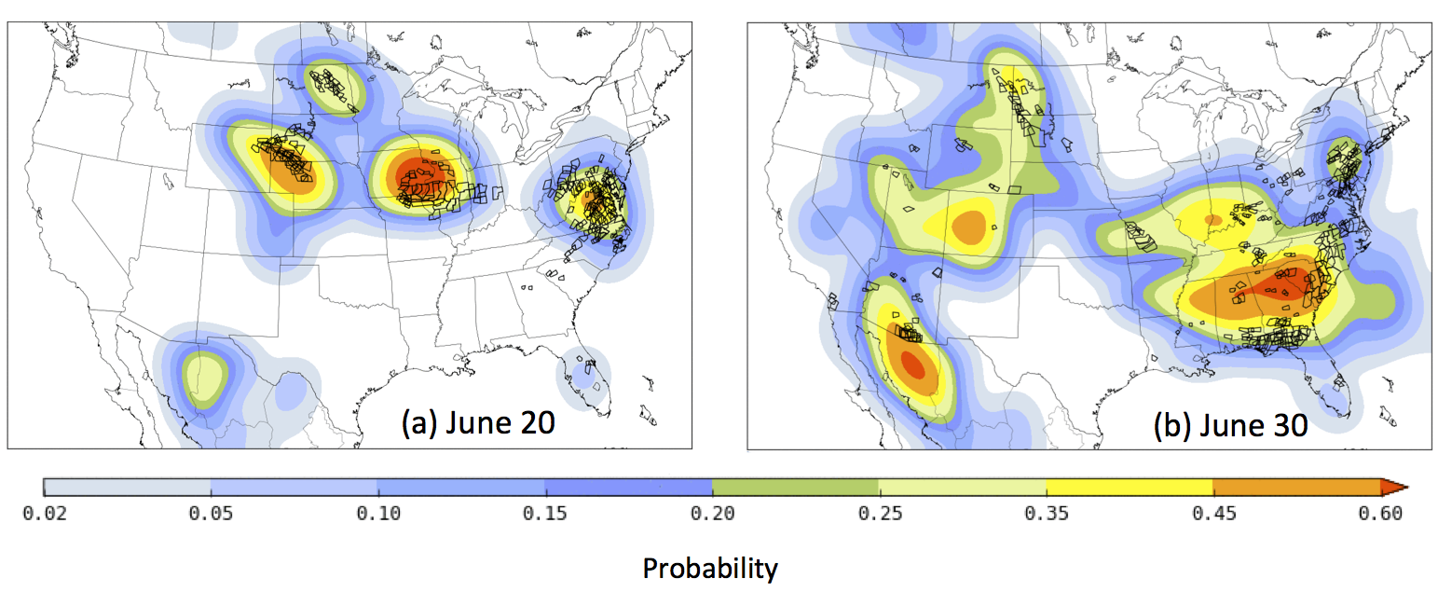
NCAR Real-time ensemble prediction system
Severe weather forecast for two days compared to NWS warnings
WRF, 10 member ensemble, GFS for boundary conditions
Continuous operation from April 2015 to December 2017
48 hour forecasts at 3km resolution
First continuously cycling ensemble system for CONUS
CISL Dedicated Queues and Computing Support were Vital
CISL Seminar: 6 Nov 2019 page 28
Notes:
Examples of forecast probabilities of daily hazardous local storms during June 2015 from NCAR’s real-time ensemble prediction system. These results are based on NCAR’s Data Assimilation Research Testbed (DART) and a high resolution version of the Weather Research and Forecast model (WRF) to produce forecasts of severe storm events. In this study a 10-member ensemble is used to identify representations of individual storm hazards. These are then combined to generate probabilistic severe storm guidance for a 24-hour forecast period. Higher probabilities (warmer fill colors) indicate a higher forecast probability of hazardous storms occurring within a particular region. The two plots in this figure illustrate different distributions of severe storm events for the U.S., highlighting the range of skill that these ensemble forecasts have in predicting high-impact weather events. Overlain in black polygons are areas where local National Weather Service (NWS) forecast offices issued either tornado or severe thunderstorm warnings. Probabilistic forecasts of weather hazards based on ensembles is an active area of research, and this study evaluates how some new measures of severe weather vary over the full area of the the conterminous United States. In particular, this work is novel in using a regional-scale ensemble method as the initial conditions to make the forecasts, and also in using new diagnostics to assess the forecast skill. Future activities planned for the ensemble system include plans to compare this work to the operational GSI system and to consider forecasting winter weather hazards.
----- Meeting Notes (5/4/16 11:08) -----
high res. last bullet key.
coloring is probability of severe weather. black is predictions from NWS. Future work to understand predictability. "Forecast skill" - early days.

Slide 29

Cool Science Example 2
DAReS Lead
Kevin Raeder
With DAReS since 2003.
Previously with CGD.
Forecast Model
CAM6 (Community Atmosphere Model)
CESM (Community Earth System Model)
Science Collaborator
CGD, Washington, Arizona, Utah
DA Capability
Ensemble Reanalysis
CISL Seminar: 6 Nov 2019 page 29

Slide 30
An Ensemble Reanalysis with CAM in CESM: Motivation
1. Evaluate weather prediction capabilities of CAM
Confront climate model with observations
Identify systematic short-term forecast errors
Compare to earlier CAM reanalysis
2. Provide forcing for CESM component model simulations
POP ocean model
CLM land surface
CICE sea ice model
Offline chemistry transport models

Slide 31
An Ensemble Reanalysis with CAM in CESM: Logistics
Target period from 1999-present.
Two overlapping streams starting in 1999, 2010.
Lots of computing (50 million Cheyenne core hours).
Thanks to NSC allocation and help from many CISL staff.

Slide 32
An Ensemble Reanalysis with CAM in CESM: Observations
Examples for single assimilation window, also assimilating AIRS satellite temperatures.

Slide 33
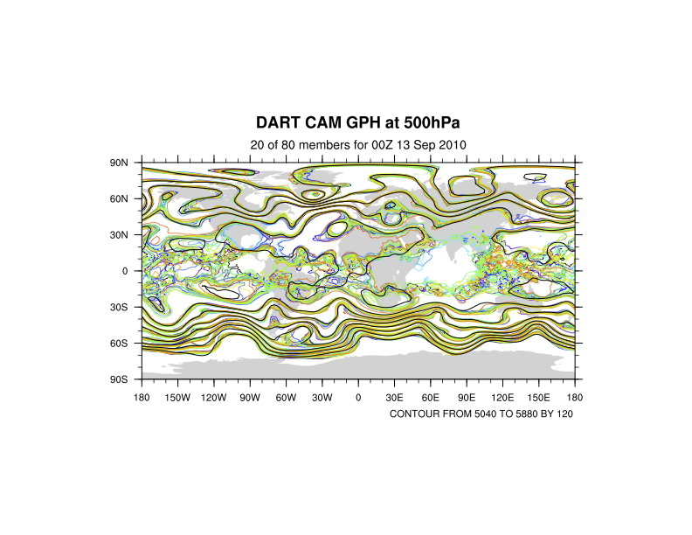
An Ensemble Reanalysis with CAM in CESM: Results
Color contours from DART (20 of 80 ensemble members). Show Uncertainty.
Black from operational NCEP analysis.

Slide 34
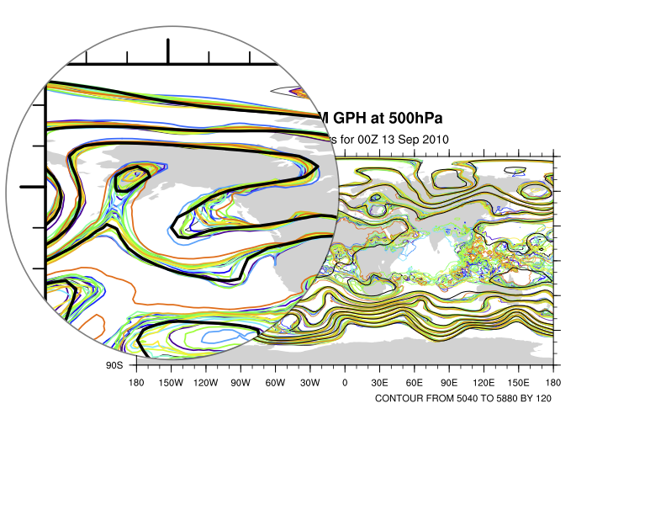
An Ensemble Reanalysis with CAM in CESM: Results
Color contours from DART (20 of 80 ensemble members). Show Uncertainty.
Black from operational NCEP analysis.

Slide 35
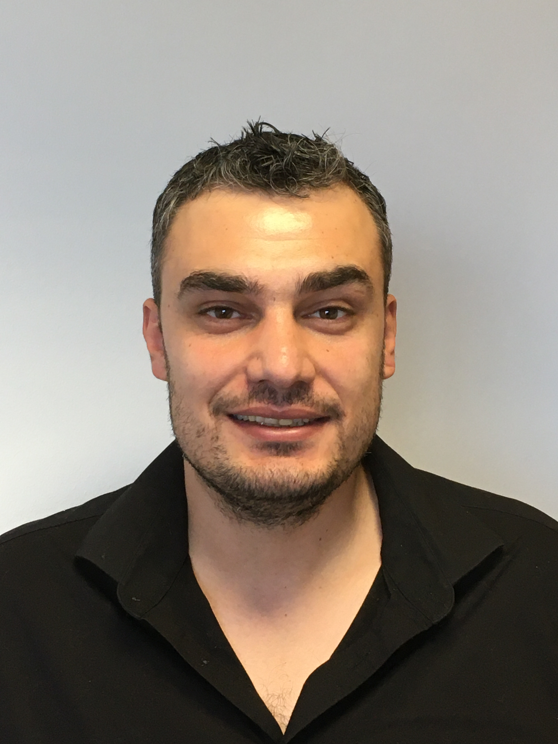

Cool Science Example 3
DAReS Leads
Moha El Gharamti
Ben Johnson
Forecast Model
WRF-Hydro®
Nearly the same as the
National Water Model
With DAReS since 2016.
Science Collaborator
RAL (James McCreight),
Texas Arlington
With DAReS since September.
DA Capability
Model Improvement
CISL Seminar: 6 Nov 2019 page 35

Slide 36
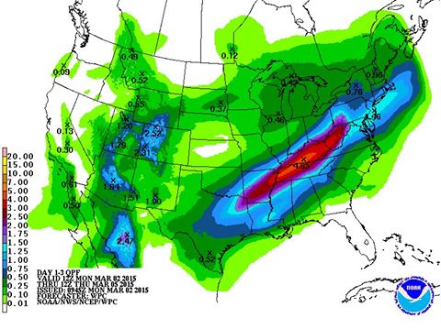
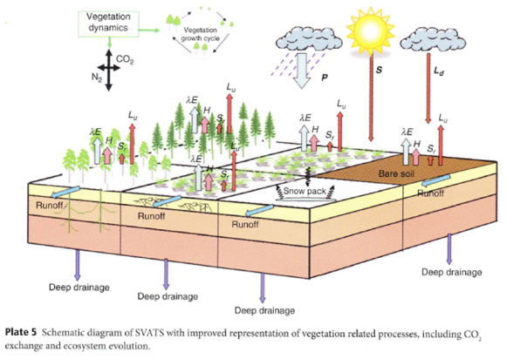
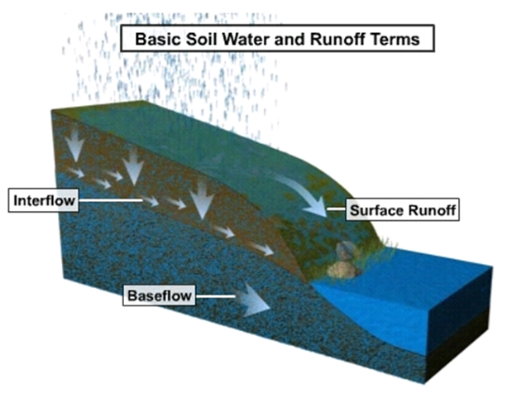
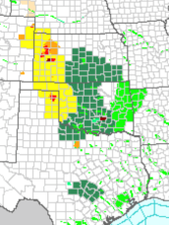
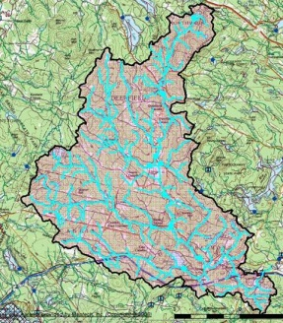
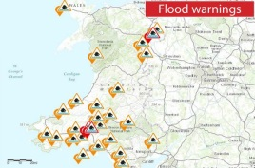
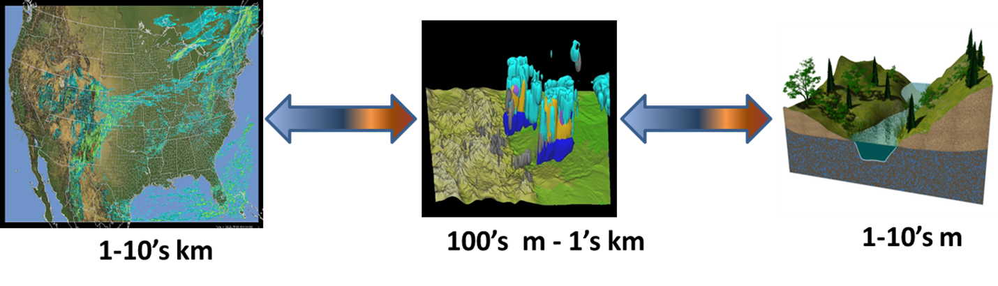
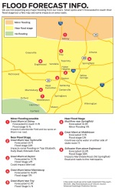
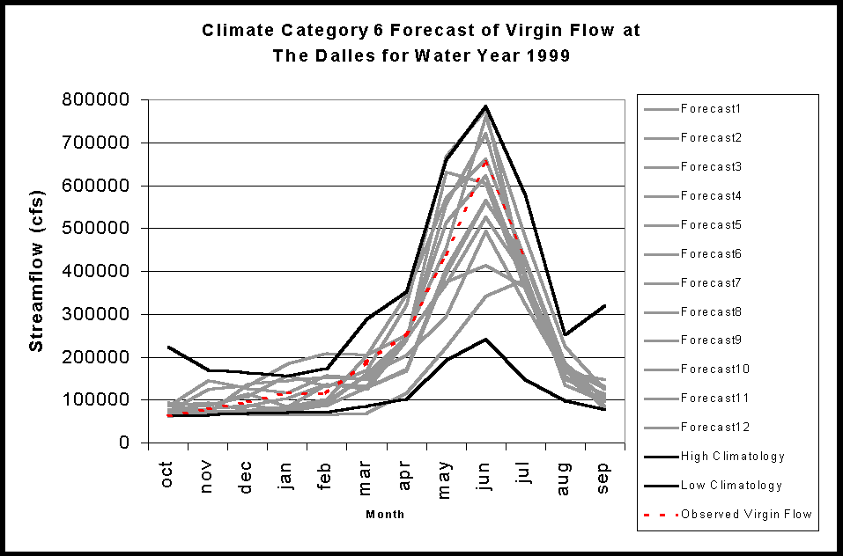
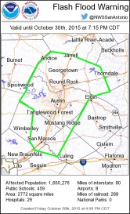
WRF-Hydro/DART: The Model
Weather Forcing Engine
WRF-Hydro: https://www.ral.ucar.edu/projects/wrf_hydro
NoahMP
Land Surface Model
Terrain Routing Module
2-way coupling
NHDPlus Catchment
Aggregation
Channel & Reservoir
Routing Module
Forecast
Products
Notes:
The core of the National Water Model system is the NCAR-supported community Weather Research and Forecasting Hydrologic model (WRF-Hydro).
Weather Forcing Engine is on a 1km grid.
Land Surface Model is on a 1km grid.
Terrain Routing is on a 250m grid.
National Hydrologic Dataset Plus (NHDPlus) Aggregation results in more than 2.7 million unique catchments and river reaches for the continental United States.
There is no capacity for uncertainty quantification in this configuration – each model has a single deterministic state that ultimately responds to whatever forcing is provided by the single estimate of weather provided by the Weather Forcing Engine.

Slide 37
WRF-Hydro/DART: DA System
Weather Engine
NoahMP LSM
ensembles
ensembles
Python environment
github.com/NCAR/wrf_hydro_py.git
Notes:
Ideally, we would like to have ensembles of all the components, with an ensemble of weather realizations (precipitation, temperature, wind) to faithfully represent the uncertainty of the entire system.
Here, we just focus on the Channel-Only configuration that also has a groundwater bucket contribution. To overcome the limitations of having a single deterministic state, we generate an ensemble of streamflow states for the Channel Module by perturbing a single state with various noise distributions. Then, in the course of an assimilation experiment, it is necessary to sustain some sort of ensemble spread - so we have parametric noise models for both the overland flux and groundwater flux contributions to the Channel Model. The overland flux is intermittent and generally quite small or zero, so the noise is only added for periods when the overland flux is greater than zero. However, since the groundwater flux is uncertain, the noise model is invoked at every step.
The whole thing can be run in docker and comes with a python workflow manager.
The WRF-Hydro team at RAL has configured a test case that encompasses the landfall region of Hurricane Florence

Slide 38
WRF-Hydro/DART: Florence 2018
Hurricane Florence made landfall near Wrightsville Beach, North Carolina at 7:15 a.m. ET September 14. The GOES East satellite captured this geocolor image at 7:45 a.m. ET
Winds up to 150 mph (240 km/hr)
Damage: $24.23 billion
NOAA/NWS/NCEP/WPC
30+” of rain
Notes:
That little arc of coastline is your reference point for some of the remaining figures. For scale, the straight-line distance from point-to-point is a bit more than 40 miles.
Hurricane Florence was a long-lived Cape Verde hurricane and the wettest tropical cyclone on record in the Carolinas. The sixth named storm, third hurricane, and the first major hurricane of the 2018 Atlantic hurricane season, Florence originated from a strong tropical wave that emerged off the west coast of Africa on August 30, 2018. Florence became a tropical depression near Cape Verde on August 31 and progressed west-northwest, becoming a Tropical Storm on September 1. Florence strengthened rapidly on September 4–5, becoming a Category 4 storm on the Saffir-Simpson wind scale with maximum sustained winds of 130 mph. Florence weakened to a tropical storm by September 7, but the system regained hurricane strength on September 9 and major hurricane status with winds of 140 mph on September 10. However, increasing wind shear caused the storm's winds to gradually weaken over the next few days. However, the storm's wind field continued to grow. By the evening of September 13, Florence had been downgraded to a Category 1 hurricane. Hurricane Florence made landfall near Wrightsville Beach early on Friday September 14, and weakened further as it slowly moved inland.

Slide 39

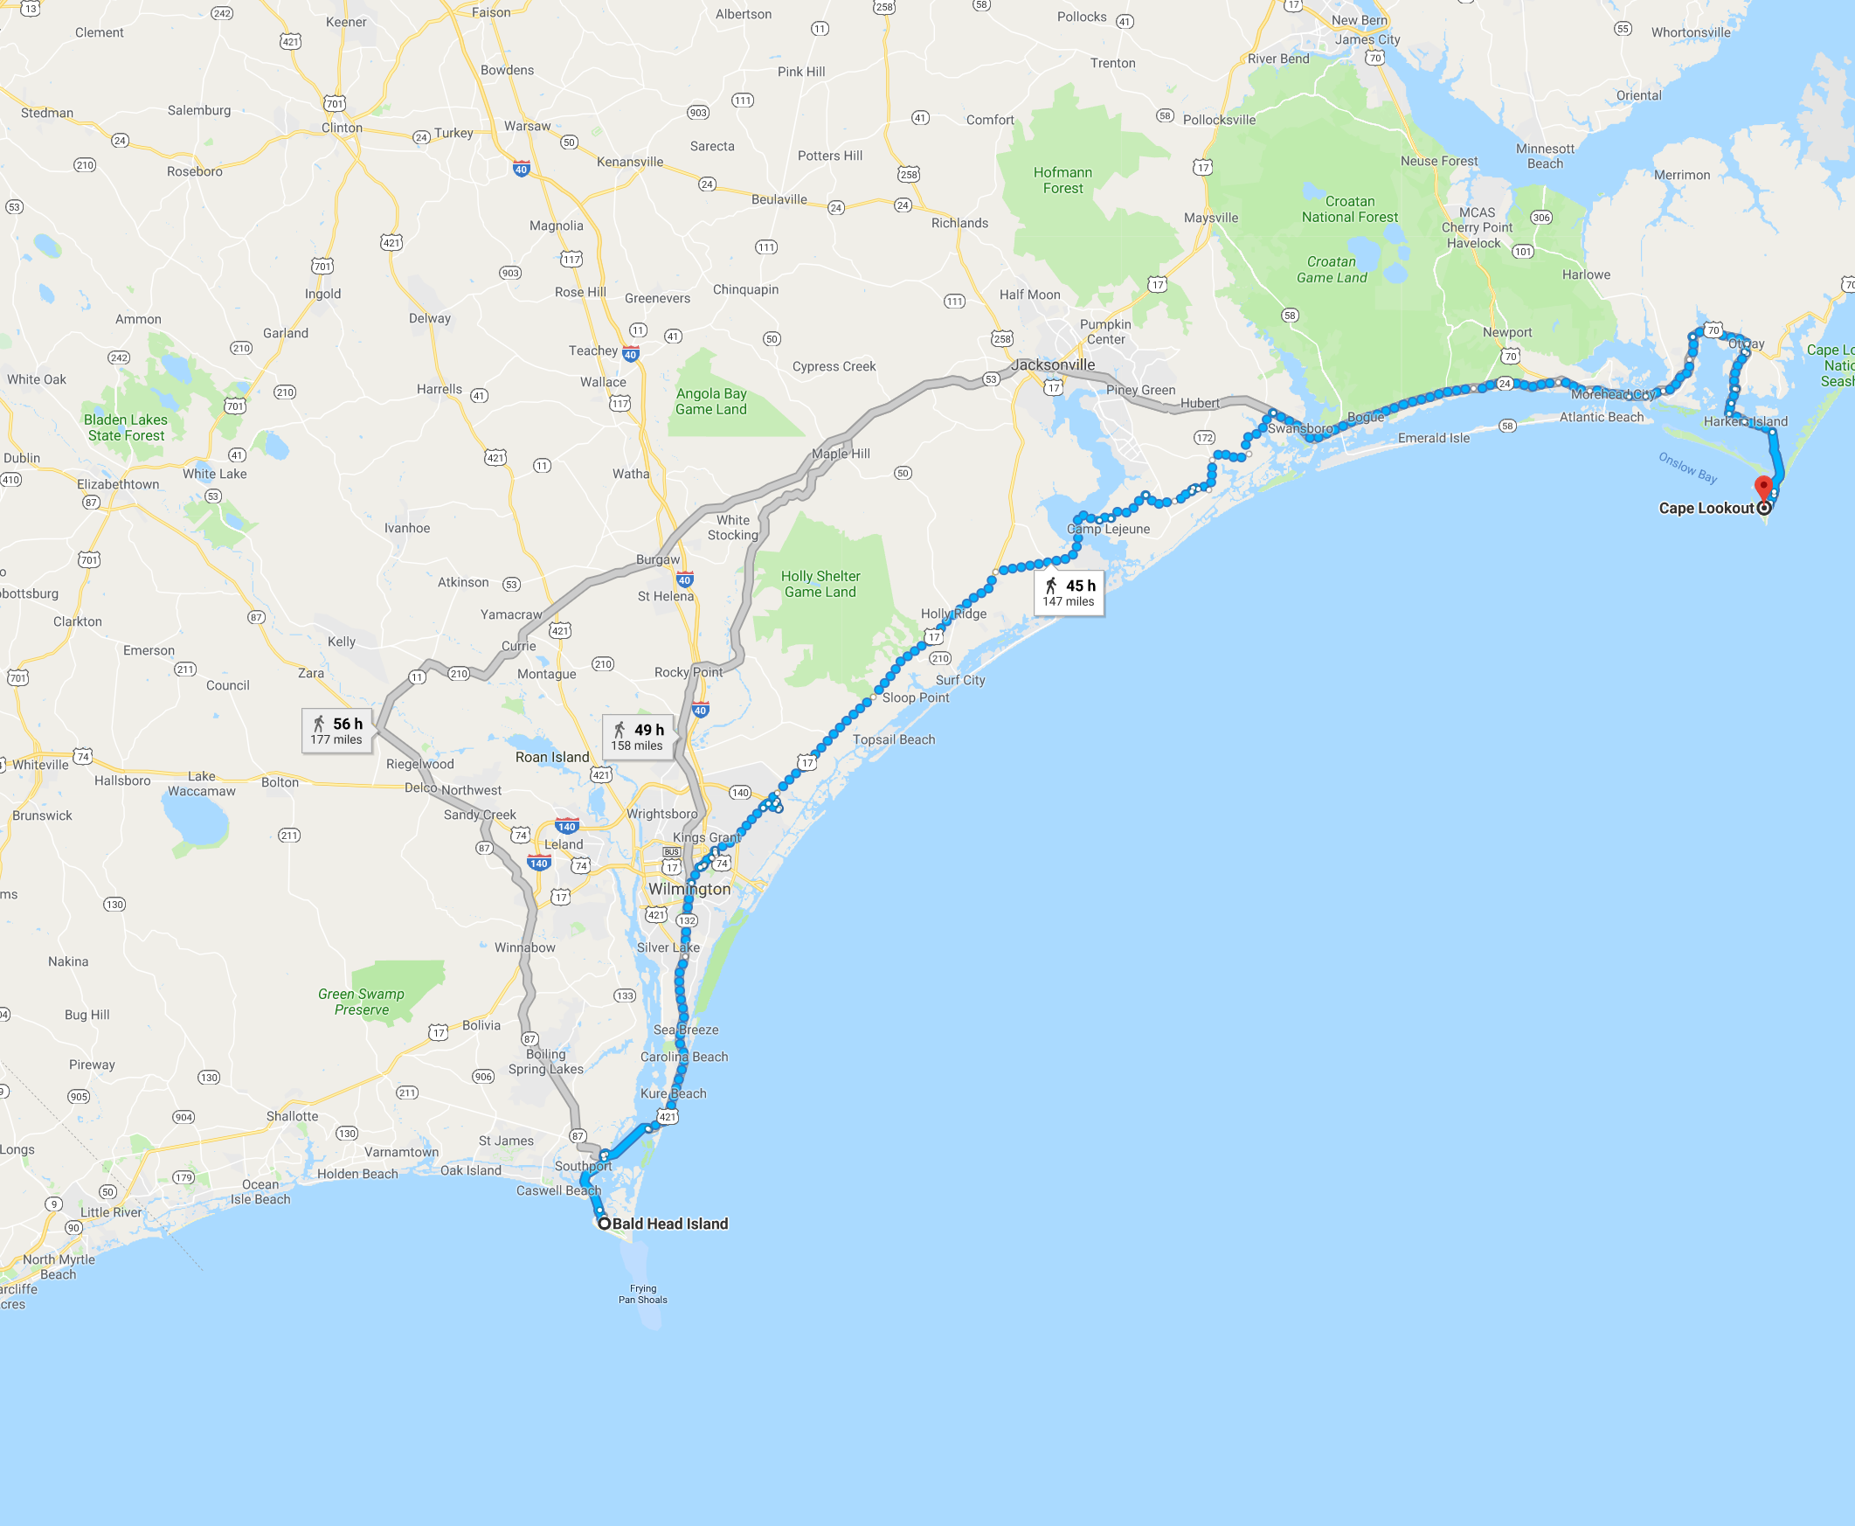


WRF-Hydro/DART: The Florence Region
About 42 miles
Bald Head Island, NC to Cape Lookout, NC 28531 Walk 147 miles, 45 h

Slide 40
WRF-Hydro/DART: No DA Control
Monthly mean of the model. The streamflow is driven by the precipitation.
More than 100 gauges, reporting every 15 mins.
Now, what happens when streamflow gauge data is incorporated through DA?
cms is m³/s
cms is m³/s
Notes:
We use an 80 member ensemble. Unstructured grid with more than 50,000 links.
Streamflow data available at more than 100 gauges every 15 mins. Gauge locations is given in black circles.
We run an open loop; i.e., 80 member ensemble forward in time with no assimilation of data. The goal is to assess the performance of the model, detect biases, … This is later compared to a DA run, that uses adaptive inflation (both in space and time), a new pattern-based localization and Gaussian Anamorphosis (variable transform).
Prior to this, we spin up the entire 80 members (with perturbed forcings) for around a month.
What you see in figure is the time-averaged ensemble mean over the simulation period (9/7 – 10/7), obtained using the control configuration. Line thickness and color represent flow.

Slide 41
WRF-Hydro/DART: DA Impact
Assimilation happens every hour
Correction along major reaches. DA is adding water to the stream channels.
Upstream
Downstream
720 hourly assimilation cycles
Notes:
Difference between posterior mean (DA) and Control. On average, DA seems to add water to the channels suggesting that the model underestimates the streamflow compared to the observations.
Major update happens along the main stream channels.
I’m going to focus on the two gauges highlighted here.

Slide 42
WRF-Hydro/DART: Bucket Problems
Weather Engine
NoahMP LSM
ensembles
ensembles
Python environment
github.com/NCAR/wrf_hydro_py.git
Notes:
Ideally, we would like to have ensembles of all the components, with an ensemble of weather realizations (precipitation, temperature, wind) to faithfully represent the uncertainty of the entire system.
Here, we just focus on the Channel-Only configuration that also has a groundwater bucket contribution. To overcome the limitations of having a single deterministic state, we generate an ensemble of streamflow states for the Channel Module by perturbing a single state with various noise distributions. Then, in the course of an assimilation experiment, it is necessary to sustain some sort of ensemble spread - so we have parametric noise models for both the overland flux and groundwater flux contributions to the Channel Model. The overland flux is intermittent and generally quite small or zero, so the noise is only added for periods when the overland flux is greater than zero. However, since the groundwater flux is uncertain, the noise model is invoked at every step.
The whole thing can be run in docker and comes with a python workflow manager.
The WRF-Hydro team at RAL has configured a test case that encompasses the landfall region of Hurricane Florence

Slide 43


Cool Science Example 4
DAReS Leads
Tim Hoar
Xueli Huo
Forecast Model
CLM (Community Land Model)
With DAReS since 2003.
Science Collaborator
UCAR (Andy Fox)
CGD, Arizona, Utah
Long-term visitor from Arizona.
DA Capability
Predictability
CISL Seminar: 6 Nov 2019 page 43

Slide 44






Biogeochemical cycles
CLM4.5
Surface energy fluxes
Hydrology
Diffuse solar
Precipitation
Photosynthesis
BVOCs
Direct solar
Downwelling
longwave
Momentum flux
Wind speed
Fire
Autotrophic
respiration
0
u_{a}
Transpiration
Sensible heat flux
Evaporation
Latent heat flux
Reflected solar
Absorbed solar
Emitted
longwave
Throughfall
Phenology
Vegetation C/N
Aerosol
deposition
Dust
Sublimation
Evaporation
N dep
N fix
CH₄
Melt
Infiltration
Surface
runoff
Heterotrop.
respiration
N₂O
SCF
Litterfall
Surface
water
Ground heat flux
Saturated
fraction
Soil (sand, clay, organic)
Soil
Root litter
Denitrification
N leaching
Aquifer recharge
Soil
C/N
Water table
N mineralization
N
uptake
Sub-surface
runoff
Bedrock
Unconfined aquifer
Glacier
Lake
Runoff
Disturbance
Wetland
River
Routing
Competition
Flooding
Crops
Irrigation
Vegetation Dynamics
River discharge
Land Use
Change
Urban
Wood harvest
Growth
CISL Seminar: 6 Nov 2019 page 44
Slides from Dave Lawrence, CGD.

Slide 45

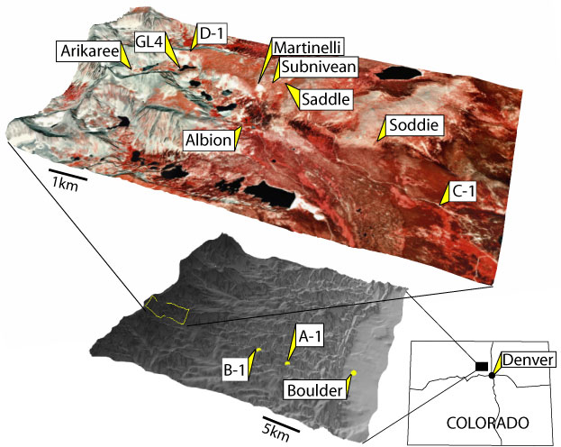
In collaboration with Andy Fox (U. Arizona) An experiment at Niwot Ridge
Estimating Ecosystem Variables in CLM
9.7 km east of the Continental Divide
C-1 is located in a Subalpine Forest
(40º 02' 09'' N; 105º 32' 09'' W; 3021 m)
One column of Community Land Model (CLM)
Spun up for 1500 years with site-specific information.
64 ensemble members
Forcing from the DART/CAM reanalysis,
Assimilating tower fluxes of latent heat (LE), sensible heat (H), and net ecosystem production (NEP).
Impacts CLM variables: LEAFC, LIVEROOTC, LIVESTEMC, DEADSTEMC, LITR1C, LITR2C, SOIL1C, SOIL2C, SOILLIQ … all of these are unobserved.
CISL Seminar: 6 Nov 2019 page 45

Slide 46
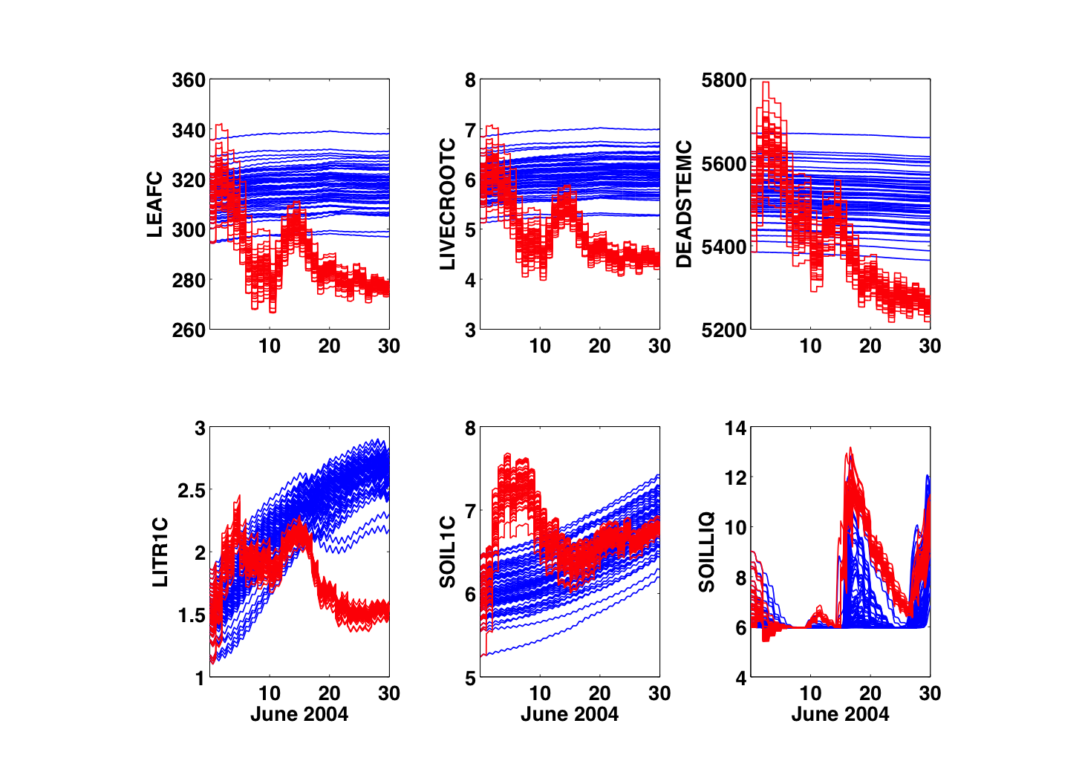
Estimating Ecosystem Variables in CLM
Unobserved variables are updated.
Free Run
Assim
June 2004

Slide 47
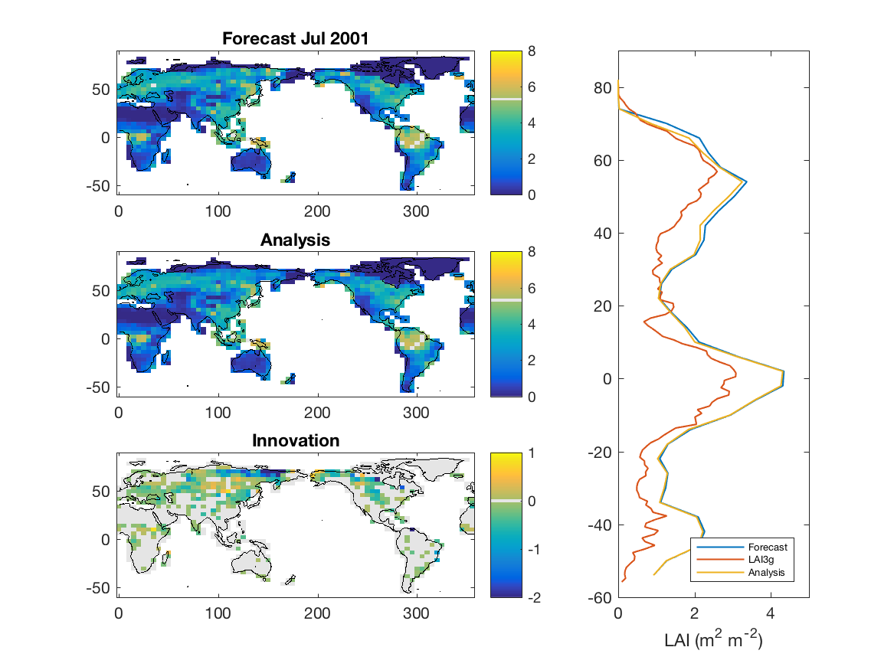
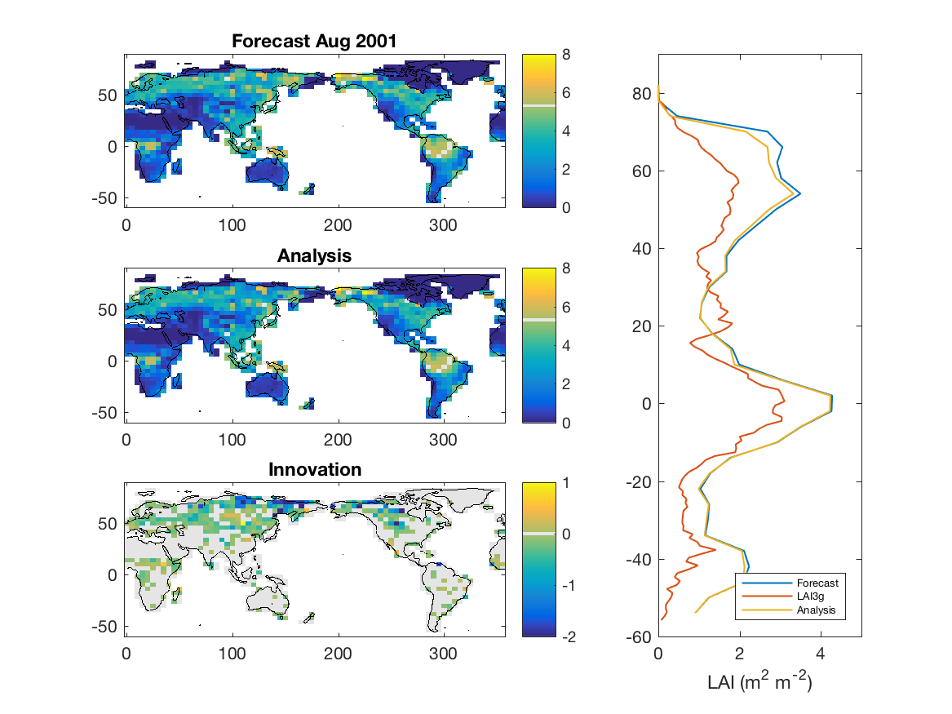
Estimating Ecosystem Variables in CLM
Global case. Remote sensing DA changes to Leaf Area Index estimates.
CISL Seminar: 6 Nov 2019 page 47

Slide 48
Cool Science Example 5
DAReS Lead
Jeff Anderson
With DAReS since before it existed.
Forecast Model
WACCM-X
Whole Atmosphere Community Climate Model, Extended Top
Science Collaborator
HAO (Nick Pedatella)
Colorado
DA Capability
Observing System Evaluation
CISL Seminar: 6 Nov 2019 page 48

Slide 49
Deep Atmospheric Component Coupled DA
WACCMX:
2 degrees, 126 levels, top at 4.1x10⁻¹⁰ hPa (more than 500 km)
High-top extension of CAM
Includes ionospheric processes
Persistence forecasts of solar and geomagnetic forcing
Observations:
All in situ plus GPS refractivity in troposphere/lower stratosphere
Temperature from AURA Microwave Limb Sounder (MLS)
Temperature from TIMED/SABER
Temperatures only up to 100km
DART:
40 members
Adaptive inflation, GC localization
6-hour window
CISL Seminar: 6 Nov 2019 page 49

Slide 50
Deep Atmospheric Component Coupled DA
Impact of Stratospheric Sudden Warming on ionosphere
Forecast (top panel), reanalysis (middle), and independent obs of Total Electron Content.
Agreement of forecast with observations indicates significant prediction skill.
CISL Seminar: 6 Nov 2019 page 50

Slide 51

Cool Science Example 6
DAReS (Honorary) Lead
Arthur Mizzi
(Had ACOM/CISL joint)
Now with State of Colorado.
Often at Mesa Lab on Friday.
Forecast Model
WRF/Chem (WRF with Chemistry)
Science Collaborator
State of Colorado
ACOM
UC Berkeley
DA Capability
Observing System Design
CISL Seminar: 6 Nov 2019 page 51

Slide 52
Air Quality Prediction Example
Xueling Liu, Ron Cohen, Inez Fung UC Berkeley.
Build NO₂ prediction system for Denver Metro.
Model is WRF/CHEM.
Observations are in situ plus satellite NO₂ (and NWP obs).
An observing system simulation experiment.
(No real observations yet).
Source estimation at km scale is eventual goal.

Slide 53
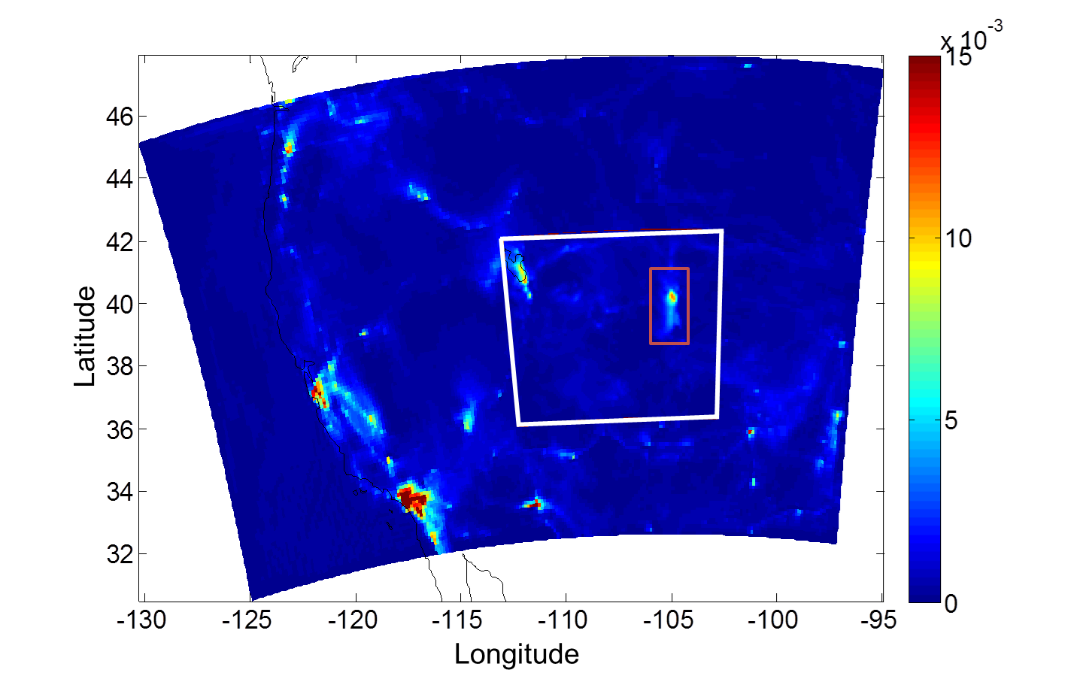
Air Quality Prediction Example
12 km outer domain and 3 km inner domain.
Weather observations assimilated on inner domain.
TEMPO NO₂ observations assimilated in red rectangle.

Slide 54
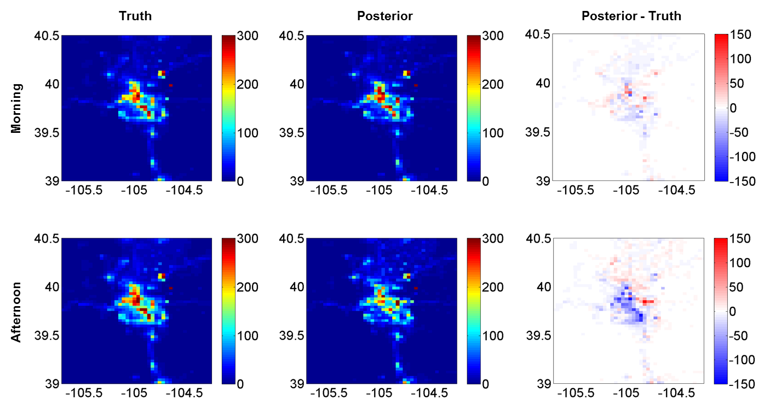
Air Quality Prediction Example
System also estimates emissions.
9:00 am (top) 4:00 pm (bottom) on July 3rd.
Comparison of analysis to specified truth.

Slide 55


Cool Science Example 7
DAReS Leads
Jeff Steward
Nancy Collins
Forecast Model
WP-GITM (Ocean Wave Propagation-Global Ionosphere Thermosphere Model)
With DAReS since September.
Science Collaborator
JPL (Panagiotis)
With DAReS since 2006.
DA Capability
Sensitivity
CISL Seminar: 6 Nov 2019 page 55

Slide 56
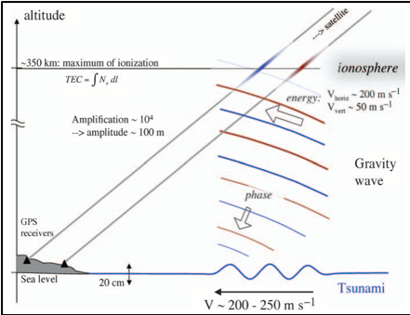
Observing Tsunamis via the Ionopshere
Tsunamis make very small changes to sea surface height in open ocean.
But, waves amplify in the atmosphere, 100m plus amplitude in ionosphere.
Changes Total Electron Content (TEC) of Ionosphere.
GPS signals are slowed by electrons.
Delays at ground stations can detect tsunami impacts in ionosphere (no way)!
CISL Seminar: 6 Nov 2019 page 56

Slide 57
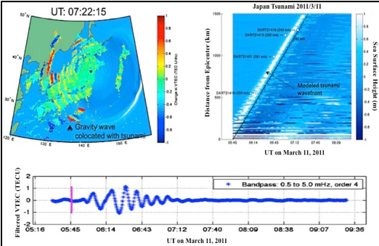
Observing Tsunamis via the Ionopshere
Tohuku example: Gravity waves in ionosphere over tsunami waves in ocean.
Use DART to find tsunami by assimilating GPS observations of TEC.
CISL Seminar: 6 Nov 2019 page 57

Slide 58

Cool Science Example 8
DAReS Lead
Dan Amrhein (80% CGD)
Dan sits in A-tower but joins DAReS software standups.
With DAReS since September.
Forecast Model
POP/CAM/CLM/CICE in CESM
Science Collaborator
CGD (Alicia Karspeck), Washington, Oklahoma
DA Capability
Assimilation methodology.
CISL Seminar: 6 Nov 2019 page 58

Slide 59
Multiple Component POP/CAM Coupled DA
Atm Obs
CAM/DART
Ocn Obs
CAM
POP
Coupler
CICE
POP/DART
CLM
Multiple components assimilating with different DART(s) in fully-coupled CESM.
Results from
Alicia Karspeck
CISL Seminar: 6 Nov 2019 page 59

Slide 60
Multiple Component POP/CAM Coupled DA
Weakly coupled reanalysis from 1970-1981
Model:
POP, 1 degree, standard CESM configuration
CAM-FV, 1 degree, standard CESM configuration
Observations:
In-situ atmosphere observations from NCEP reanalysis
Ocean temperature and salinity, World Ocean Database
DART:
30 members
Limited adaptive inflation in ocean
Fully adaptive inflation in atmosphere
GC localization
CISL Seminar: 6 Nov 2019 page 60

Slide 61
Multiple Component POP/CAM Coupled DA
Observations are sparse for this period.
CISL Seminar: 6 Nov 2019 page 61

Slide 62
Multiple Component POP/CAM Coupled DA
Comparisons to HADISST and HADSLP.
Correlation high where observations existed.
DART did not assimilate SST products or observations.
Produces competitive reanalysis.
CISL Seminar: 6 Nov 2019 page 62

Slide 63
DAReS DA Science Research
DAReS staff develop improved algorithms that can be added to DART.
DAReS world leader in complex algorithms for:
Adaptive inflation,
Localization,
Sampling error reduction.
All of these are available and nearly universally used in DART.
CISL Seminar: 6 Nov 2019 page 63

Slide 64
DAReS DA Science Research
Most DA algorithms are Gaussian and linear.
Fit a Gaussian to ensemble members.
Do a least squares fit to ensemble.
CISL Seminar: 6 Nov 2019 page 64

Slide 65
DAReS DA Science Research
All earth system applications are Non-Gaussian and Nonlinear
Especially true for bounded quantities:
Streamflow
Relative humidity
Emission of carbon dioxide
Two Non-Gaussian, Nonlinear algorithms being tested in DART
Anamorphosis, Moha
Marginal Correction Rank Histogram Filter, Jeff A.
CISL Seminar: 6 Nov 2019 page 65

Slide 66
Gaussian Anamorphosis
Control,
Observation rejection is improved with GA.
Better fit to the observations on Sep. 17th.
Higher order moments are almost completely eliminated using GA.
Control,
Notes:
Streamflow is a positive quantity. Negative flow is not physical. The Kalman update does not respect this positiveness constraint. Hence, the distributions are not Gaussian.
GA aims at transforming the variables into Gaussian space before performing the update. The update happens in a Gaussian space (which fits the context of the KF), and then an inverse transform to the physical space is performed.
The transformation can be analytical (e.g., logarithm) or fully empirical by projecting the ensemble into standard normal distributions. This is done by constructing the inverse cdf of the ensemble and then finding its quantiles. A piece-wise linear function is then constructed using these quantiles and interpolation is used to find a smooth function.

Slide 67
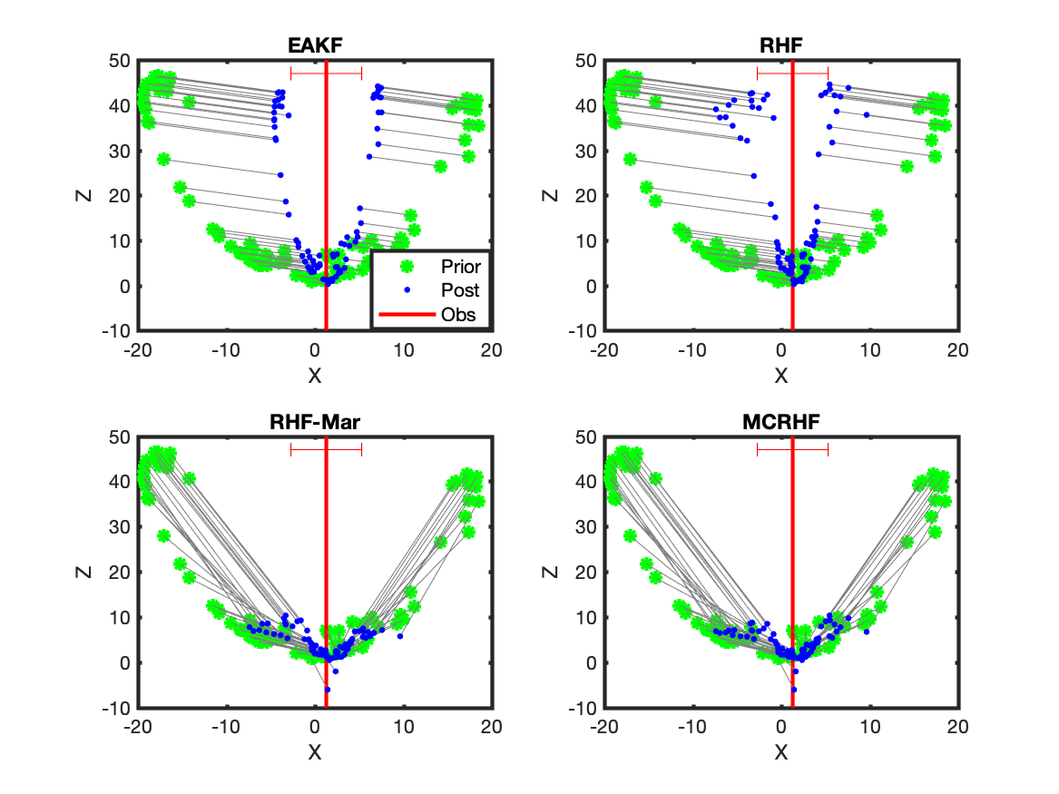
Marginal Correction Rank Histogram
Green prior.
Blue Posterior.
Lorenz-63 example: x is observed, z is not observed.
Red indicates observation and error s.d.
CISL Seminar: 6 Nov 2019 page 67

Slide 68
Interactions with CISL Colleagues
Brian Dobbins, John Dennis, Mick Coady, D. J. Gagne, many others.
Observations.
Really, really big data.
Large user of super-computing resources, need optimization.
Machine learning.
SIParCS, we love working with these students.
Why are we in CISL? Because this is the best place for us.
CISL Seminar: 6 Nov 2019 page 68

Slide 69
Some Exciting Next Steps
Fully-coupled atmosphere, ocean (land, sea-ice) DA with CGD.
DA for satellite radiance observations with CMCC/Italy.
New software for handling observations:
Better IO,
Handle correlated observation errors,
Better parallelism.
DART for SIMA, System for Integrated Modeling of the Atmosphere.
DART for MUSICA, new chemistry modeling.
Prediction with MPAS and regional MPAS (Soyoung Ha, MMM).
Priority: Stay nimble so we can work with more novel science applications.
CISL Seminar: 6 Nov 2019 page 69

